Slide 1

The Differentials

Slide 2
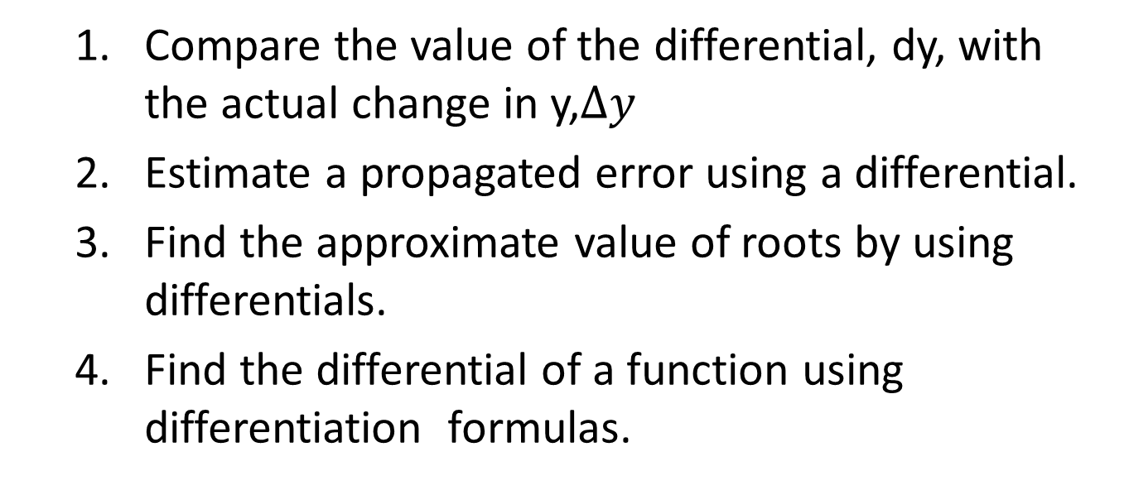
Objectives At the end of the lesson, the student should be able to:
Compare the value of the differential, dy, with the actual change in y,$∆y$
Estimate a propagated error using a differential.
Find the approximate value of roots by using differentials.
Find the differential of a function using differentiation formulas.

Slide 3
Consider a function defined by y=f(x) where x is the independent variable. In the four-step rule we introduced the symbol Δx to denote the increment of x. Now we introduce the symbol dx which we call the differential of x. Similarly, we shall call the symbol dy as the differential of y. To give separate meanings to dx and dy, we shall adopt the following definitions of a function defined by the equation y=f(x).
DEFINITION 1: dx = Δx
In words, the differential of the independent variable is equal to the increment of the variable.

Slide 4
DEFINITION 2: dy = f’ (x) dx
In words, the differential of a function is equal to its derivative multiplied by the differential of its independent variable.
We emphasize that the differential dx is also an independent variable, it may be assigned any value whatsoever. Therefore, from DEFINITION 2, we see that the differential dy is a function of two independent variables x and dx. It should also be noted that while dx=Δx, dy≠Δy in general.
Suppose dx≠0 and we divide both sides of the equation
dy = f’ (x) dx

Slide 5
by dx. Then we get
Note that this time dy/dx denotes the quotient of two differentials, dy and dx . Thus the definition of the differential makes it possible to define the derivative of the function as the ratio of two differentials. That is,
The differential may be given a geometric interpretation. Consider again the equation y=f(x) and let its graph be as shown below. Let P(x,y) and Q(x+Δx,f(x)+Δx) be two points on the curve. Draw the

Slide 6
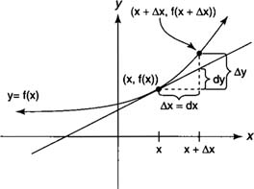
tangent to the curve at P. Through Q, draw a perpendicular to the x-axis and intersecting the tangent at T. Then draw a line through P, parallel to the x-axis and intersecting the perpendicular through Q at R. Let θ be the inclination of the tangent PT.
Q
T
P
θ
R

Slide 7
From Analytic Geometry, we know that
slope of PT = tan θ
But triangle PRT, we see that
However, Δx=dx by DEFINITION 1 . Hence
But the derivative of y=f(x) at point P is equal to the slope of the tangent line at that same point P.
slope of PT = f’(x)
Hence,

Slide 8
And , RT = f’(x) dx
But, dy = f’ (x) dx
Hence, RT = dy
We see that dy is the increment of the ordinate of the tangent line corresponding to an increment in Δx in x whereas Δy is the corresponding increment of the curve for the same increment in x. We also note that the derivative dy/dx or f’(x) gives the slope of the tangent while the differential dy gives the rise of the tangent line.

Slide 9
SUMMARY: DEFINITION OF DIFFERENTIALS
Let x represents a function that is differentiable on an open interval containing x. The differential of x (denoted by dx) is any nonzero real number.
The differential of y (denoted by dy) is
dy = f(x )dx.

Slide 10
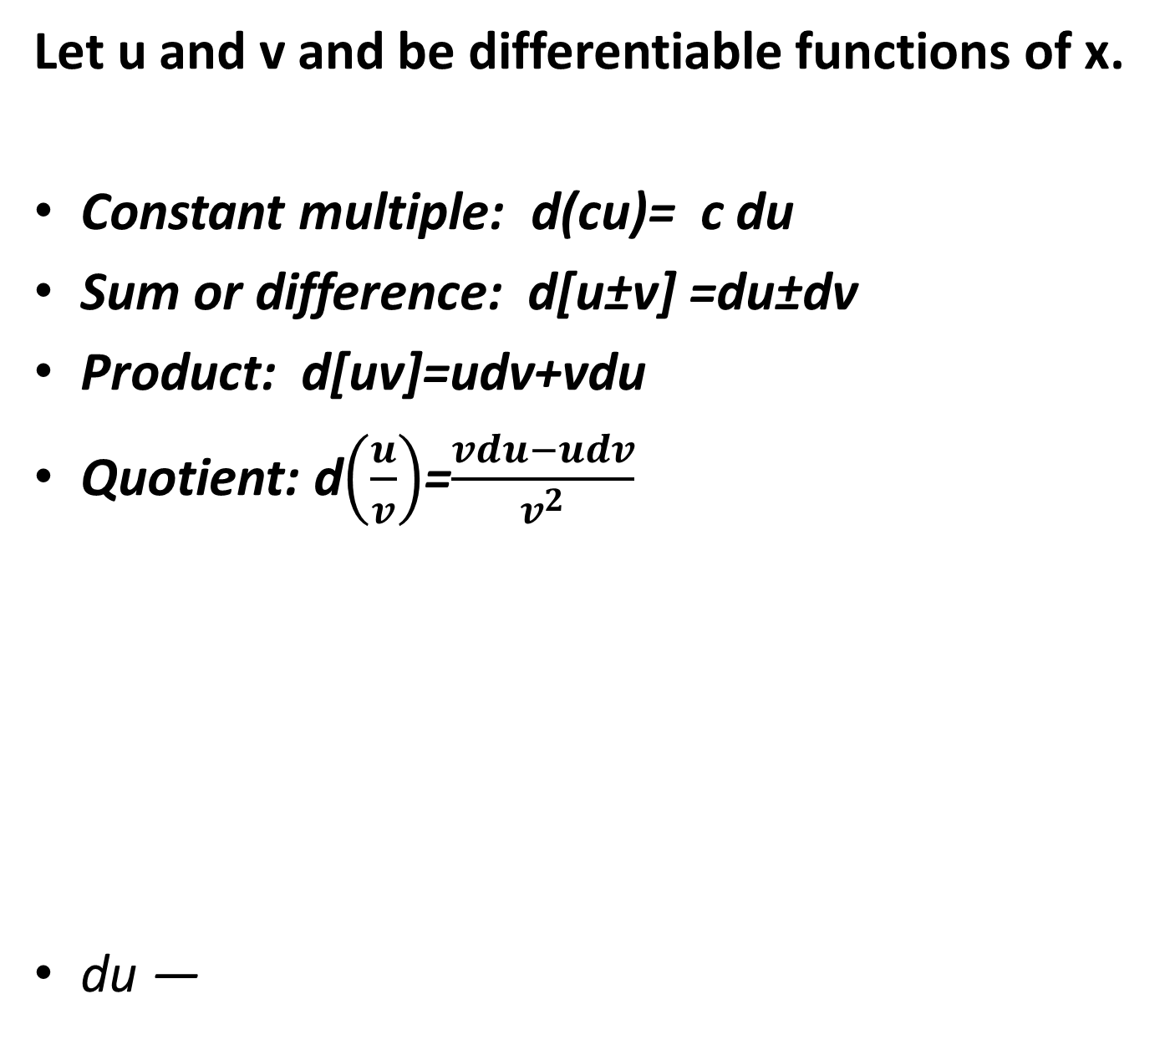
DIFFERENTIAL FORMULAS
Let u and v and be differentiable functions of x.
Constant multiple: d(cu)= c du
Sum or difference: d[u±v] =du±dv
Product: d[uv]=udv+vdu
Quotient: d$\left(\frac{u}{v}\right)$=$\frac{vdu−udv}{v^{2}}$
du ―

Slide 11
EXAMPLE 1: Find dy for y = x³ + 5 x −1.
EXAMPLE 2: Find dy for .

Slide 12
EXAMPLE 3: Find dy / dx by means of differentials
if xy + sin x = ln y .

Slide 13
EXAMPLE 1: Use differentials to approximate the change in the area of a square if the length of its side increases from 6 cm to 6.23 cm.
Let x = length of the side of the square.
The area may be expressed as a function of x, where A= x².
The differential dA is
Because x is increasing from 6 to 6.23, you find that
Δ x = dx = .23 cm; hence,

Slide 14
EXAMPLE 2: Use the local linear approximation to estimate the value of to the nearest thousandth.

Slide 15
EXAMPLE 3: If y = x³ + 2x² – 3, find the approximate value of y when x = 2.01.

Slide 16
EXAMPLE 4: Use an appropriate local linear approximation
to estimate the value of cos 31⁰.

Slide 17
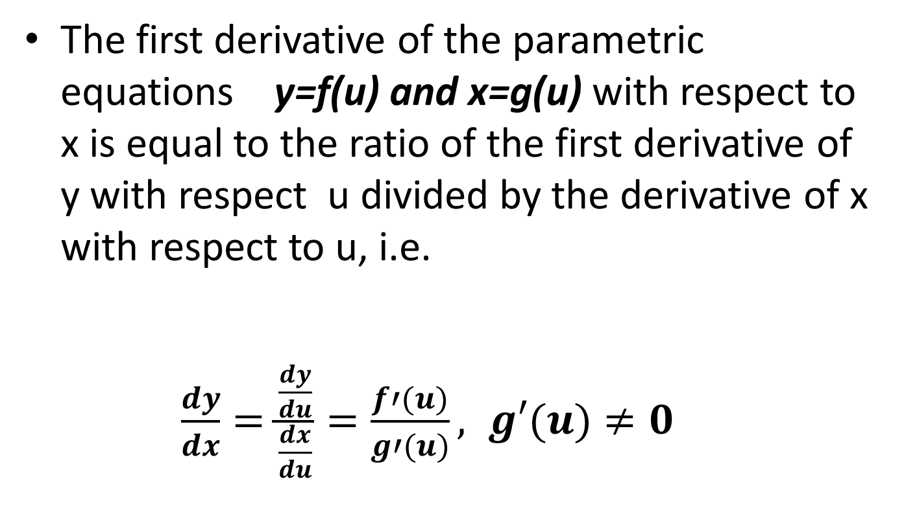
Derivative of Parametric Equations
The first derivative of the parametric equations y=f(u) and x=g(u) with respect to x is equal to the ratio of the first derivative of y with respect u divided by the derivative of x with respect to u, i.e.
$$\frac{dy}{dx}=\frac{\frac{dy}{du}}{\frac{dx}{du}}=\frac{f′(u)}{g′(u)}, g′(u)≠0$$

Slide 18
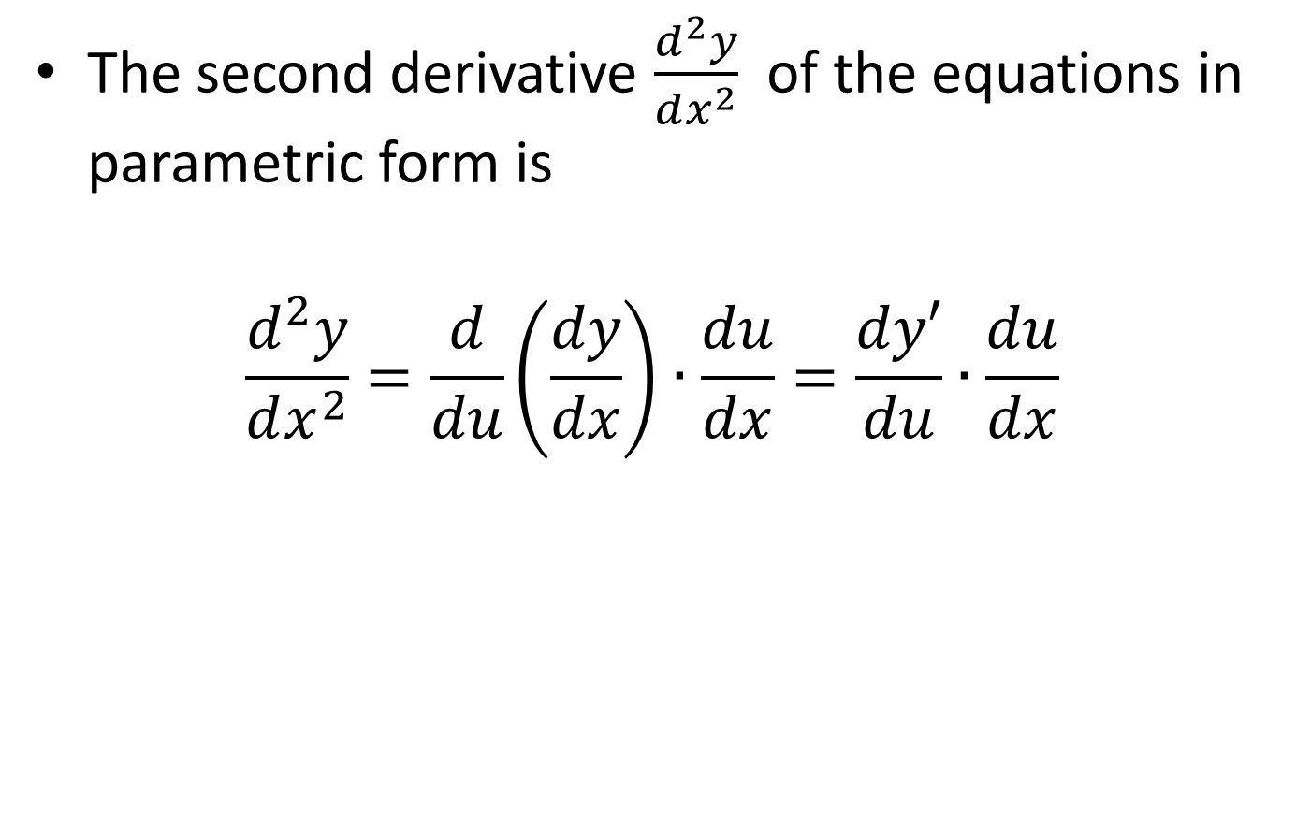
The second derivative $\frac{d^{2}y}{dx^{2}}$ of the equations in parametric form is
$$\frac{d^{2}y}{dx^{2}}=\frac{d}{du}\left(\frac{dy}{dx}\right)∙\frac{du}{dx}=\frac{dy′}{du}∙\frac{du}{dx}$$

Slide 19
EXAMPLE :
Find the derivatives of the following parametric equations :

Slide 25



Other Examples:
Use differentials to approximate the value of the following expression.
Find the differential dy of the given function.

Slide 26
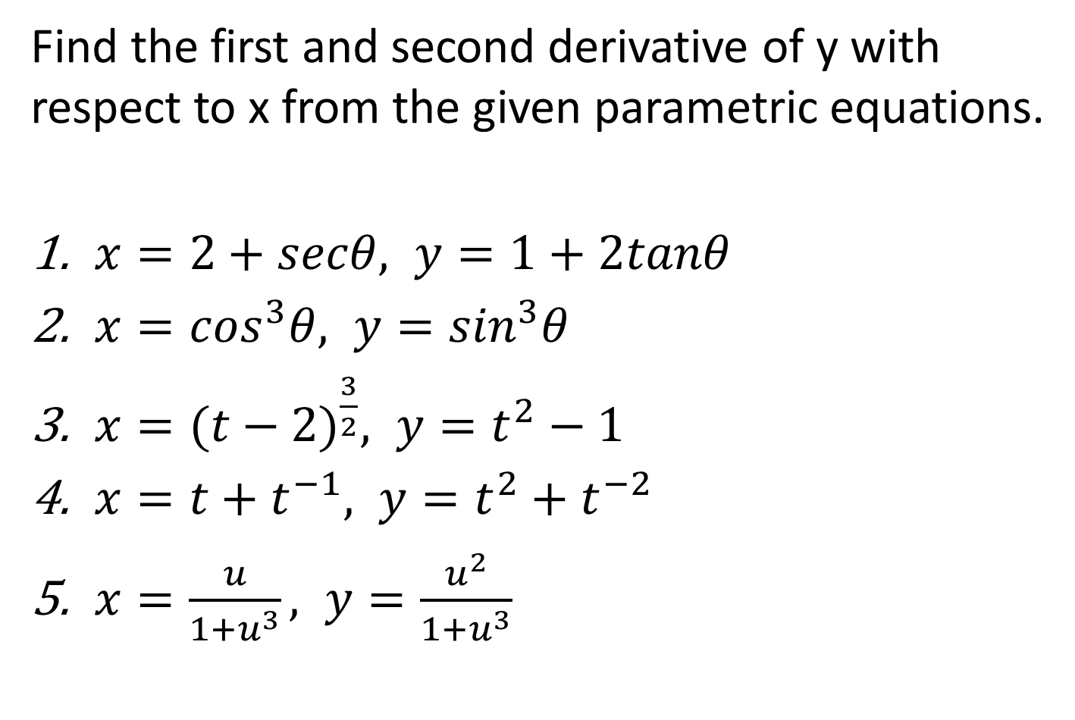
Find the first and second derivative of y with respect to x from the given parametric equations.
$x=2+secθ, y=1+2tanθ$
$x=\cos^{3}θ, y=\sin^{3}θ$
$x={(t−2)}^{\frac{3}{2}}, y=t^{2}−1$
$x=t+t^{−1}, y=t^{2}+t^{−2}$
$x=\frac{u}{1+u^{3}}, y=\frac{u^{2}}{1+u^{3}}$

Slide 27
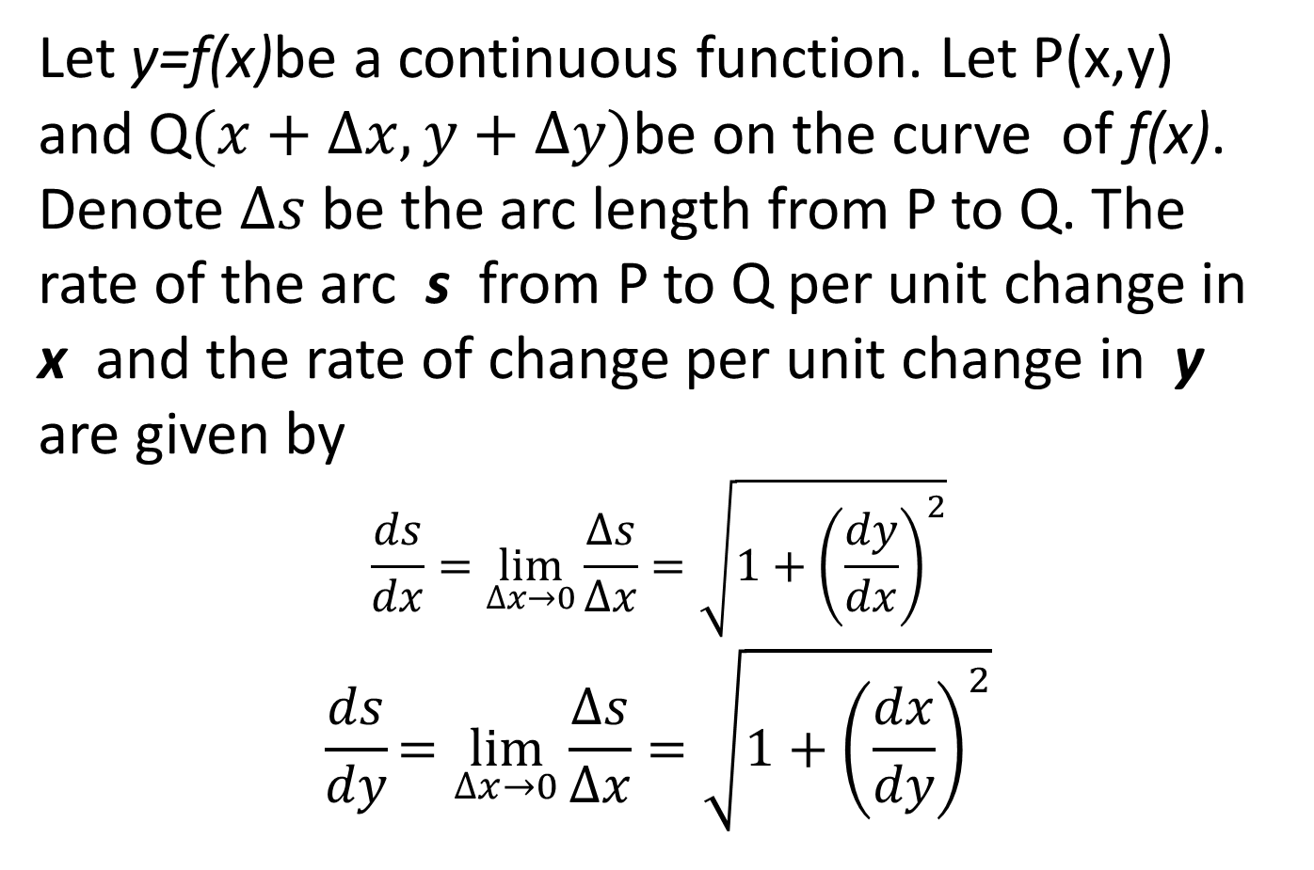
Differential of Arc Length
Let y=f(x)be a continuous function. Let P(x,y) and Q$(x+∆x, y+∆y)$be on the curve of f(x). Denote $∆s$be the arc length from P to Q. The rate of the arc s from P to Q per unit change in x and the rate of change per unit change in y are given by
$$\frac{ds}{dx}=\lim_{∆x→0}{\frac{∆s}{∆x}=\sqrt{1+{\left(\frac{dy}{dx}\right)}^{2}}}$$
$$\frac{ds}{dy}=\lim_{∆x→0}{\frac{∆s}{∆x}=\sqrt{1+{\left(\frac{dx}{dy}\right)}^{2}}}$$

Slide 28
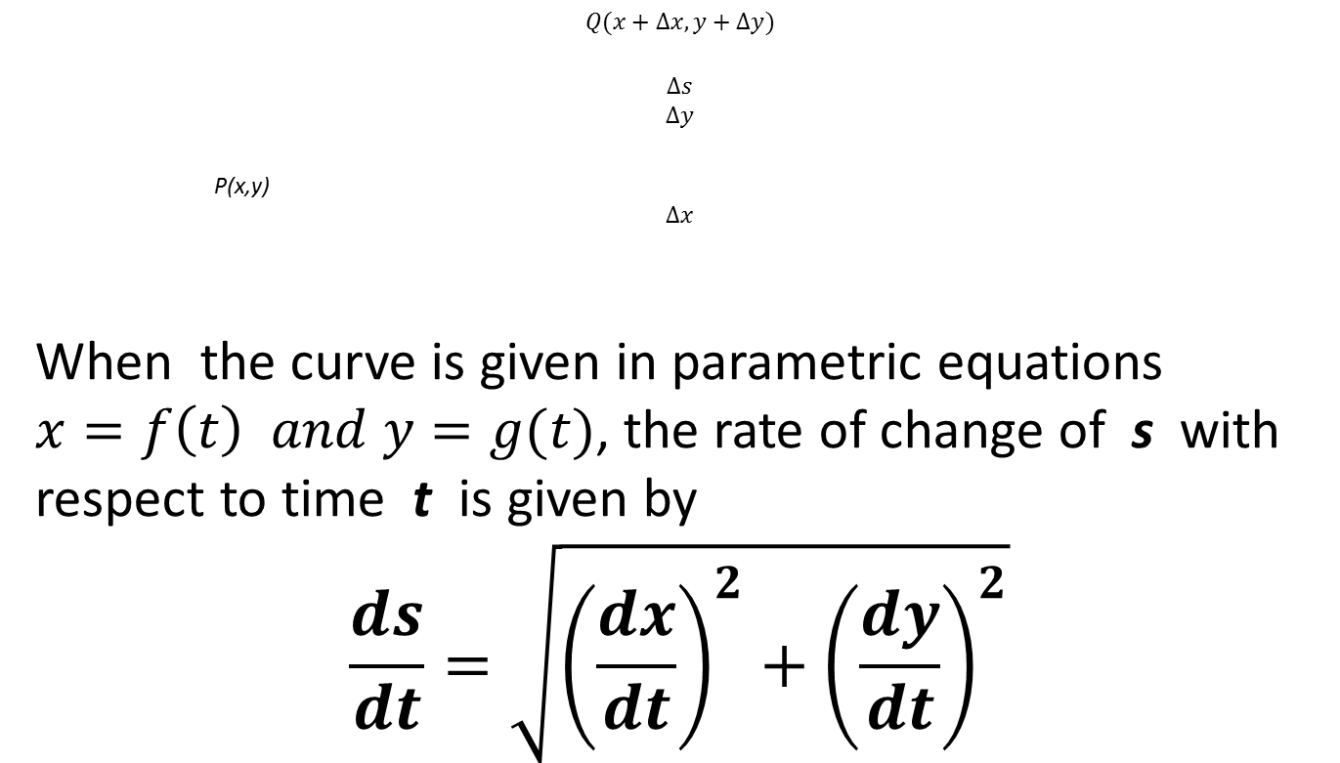
$$Q(x+∆x, y+∆y)$$
$$∆s$$
$$∆y$$
P(x,y)
$$∆x$$
When the curve is given in parametric equations $x=f\left(t\right) and y=g(t)$, the rate of change of s with respect to time t is given by
$$\frac{ds}{dt}=\sqrt{{\left(\frac{dx}{dt}\right)}^{2}+{\left(\frac{dy}{dt}\right)}^{2}}$$

Slide 29




Curvature
The curvature K (the measure of how sharply a curve bends) of a curve y=f(x), at any point P on it is the rate of change in direction, i.e. the angle of inclination $α$ of the tangent line at P per unit of arc length s.
K= $\lim_{∆s→o}{\frac{∆α}{∆s}}=\frac{ds}{dα}$ =curvature at P
$$∆α$$
$$∆s$$
$$α+∆α$$

Slide 30
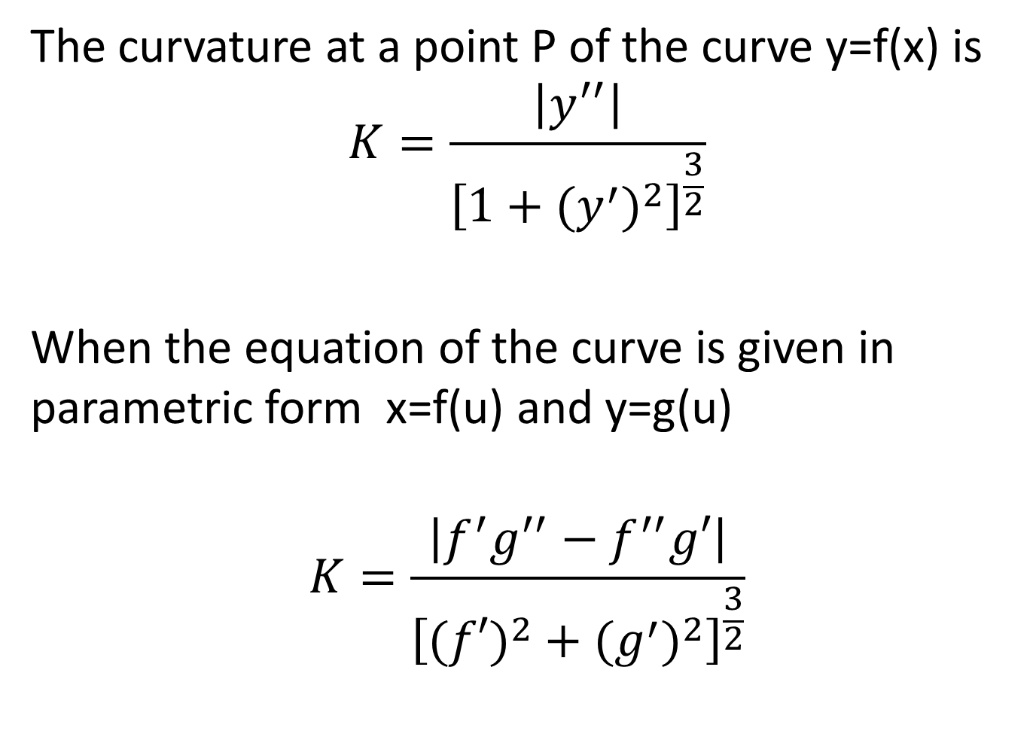
The curvature at a point P of the curve y=f(x) is
$$K=\frac{\left|y^{′′}\right|}{{\left[1+{(y^{′})}^{2}\right]}^{\frac{3}{2}}}$$
When the equation of the curve is given in parametric form x=f(u) and y=g(u)
$$K=\frac{\left|f^{′}g^{′′}−f^{′′}g′\right|}{{\left[({f′)}^{2}+{(g^{′})}^{2}\right]}^{\frac{3}{2}}}$$

Slide 31
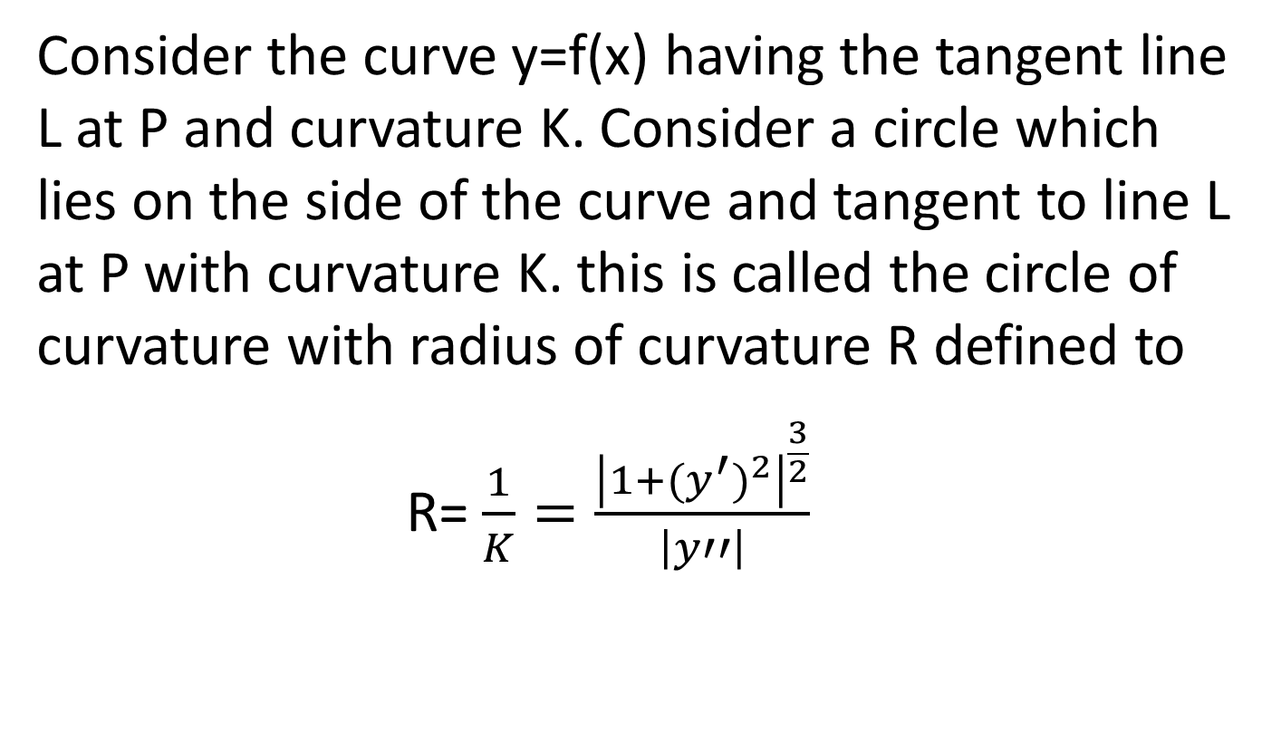
Radius of Curvature
Consider the curve y=f(x) having the tangent line L at P and curvature K. Consider a circle which lies on the side of the curve and tangent to line L at P with curvature K. this is called the circle of curvature with radius of curvature R defined to
R= $\frac{1}{K}=\frac{{\left|1+{(y^{′})}^{2}\right|}^{\frac{3}{2}}}{\left|y′′\right|}$

Slide 32
K
y
L
P
O
X

Slide 33
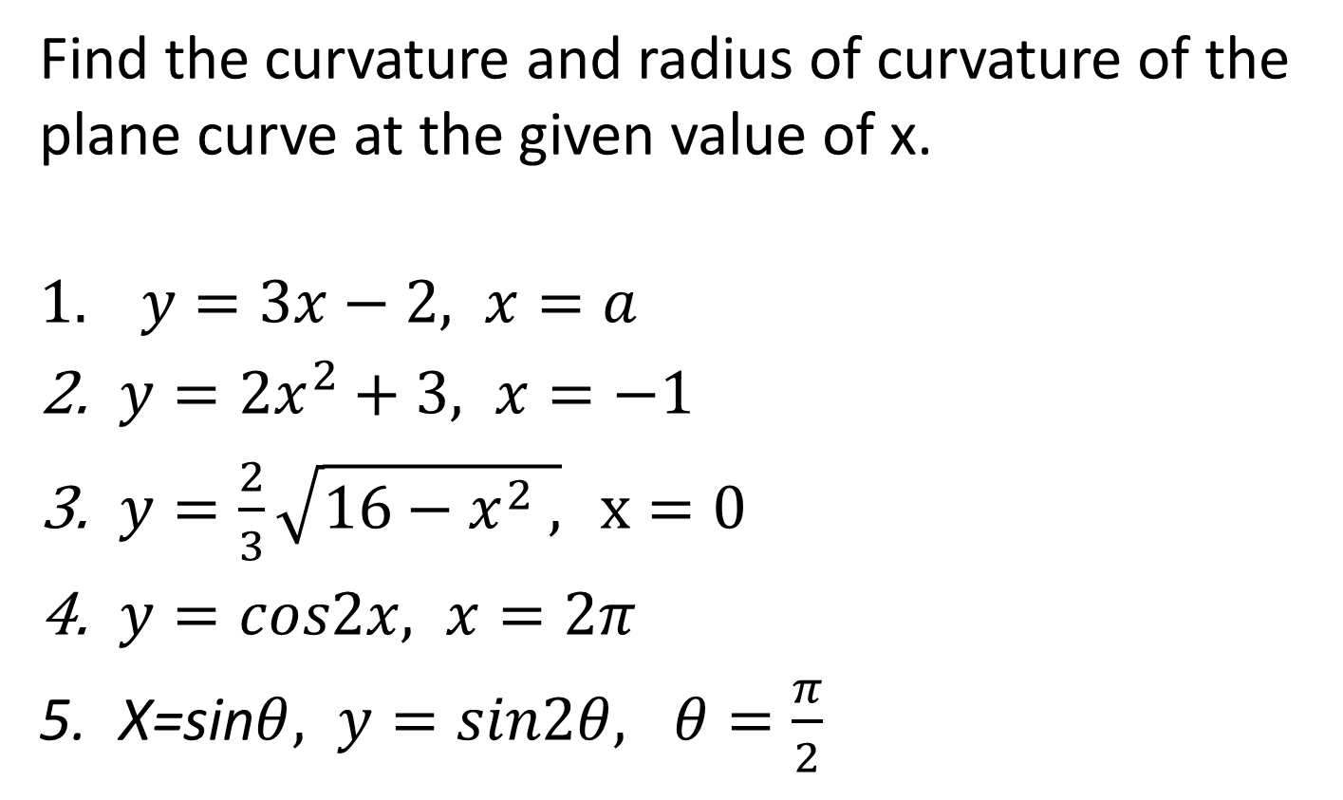
Example
Find the curvature and radius of curvature of the plane curve at the given value of x.
$$1. y=3x−2, x=a$$
$y=2x^{2}+3, x=−1$
$y=\frac{2}{3}\sqrt{16−x^{2} ,} x=0$
$y=cos2x, x=2π$
X=sin$θ, y=sin2θ, θ=\frac{π}{2}$

